Slide 1
A/B testing
Brian Caffo, Jeff Leek, Roger peng
@bcaffo
www.bcaffo.com

Slide 2
How can Jeff sell more books?

Slide 3

How can Jeff sell more books?

Slide 4
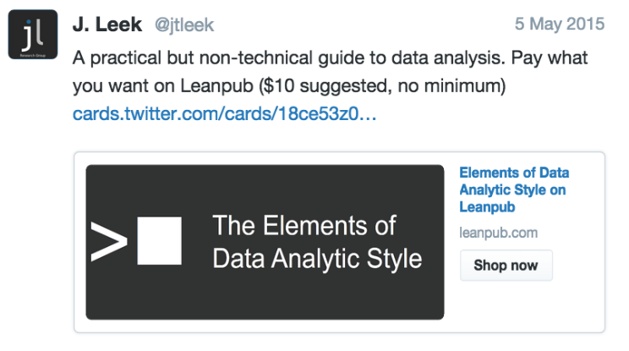
1

Slide 5
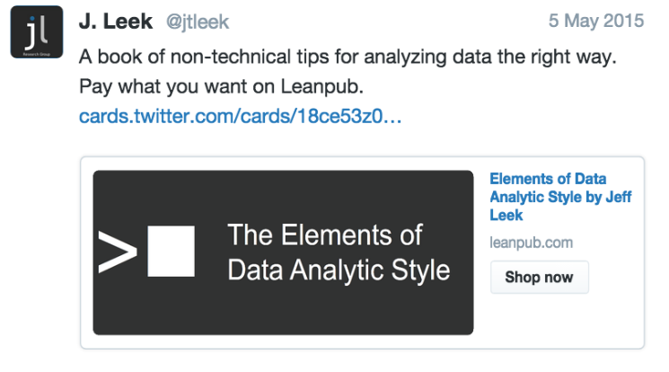
2

Slide 6

Potential Strategies
http://thenextweb.com/wp-content/blogs.dir/1/files/2013/04/calendar.jpg
Notes:
Campaign 1 on day 1 and 2 on day 2 Alias with time

Slide 7
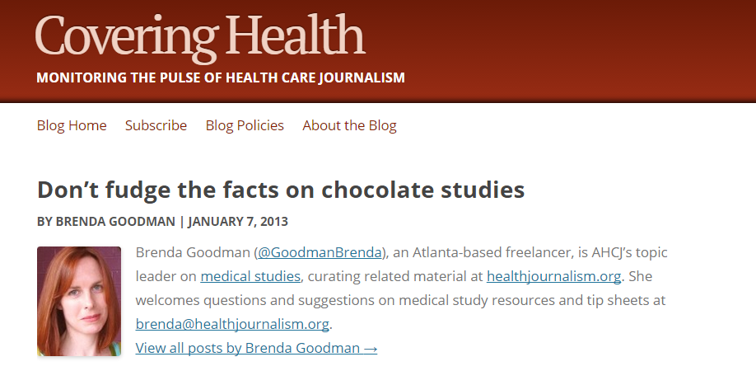
Comparable groups

Slide 8
Observational
Chocolate 5 / 8
No Chocolate 3 / 8
Red 5 / 7 Blue 3 / 9

Slide 9

Randomize?
Notes:
For each student flip a coin; if it’s heads send Email 1 and if tails send Email 2

Slide 10
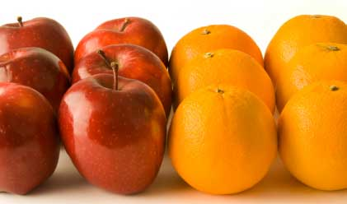
Basic principle
Compare like with like to isolate the effect of interest
http://skillsprojects.files.wordpress.com/2009/10/like_for_like.jpg
Notes:
Via randomization, with high probability the group of people who receive Email 1 should be otherwise similar to the group who received Email 2
Examples of not comparing like with like:
Not randomizing and sending Email 1 to students enrolled in his online course and Email 2 to his twitter followers.
Randomizing but sending Email 1 on a Monday and Email 2 on a Friday.

Slide 11
Fisher on randomization
Randomisation properly carried out ... relieves the experimenter from the anxiety of considering and estimating the magnitude of the innumerable causes by which his data may be disturbed
Armitage, “Fisher, Bradford Hill, and randomization”

Slide 12
Randomization
Randomization, with high probability, makes the treated and untreated groups directly comparable
Chocolate 3 / 8
No chocolate 5 / 8

Slide 13
Is randomization a cure all?

Slide 14
Randomization
Chocolate 3 / 8
No chocolate 3 / 4

